Slide 1
DIRBTINIS INTELEKTAS IR JO TAIKYMAI
1

Slide 2
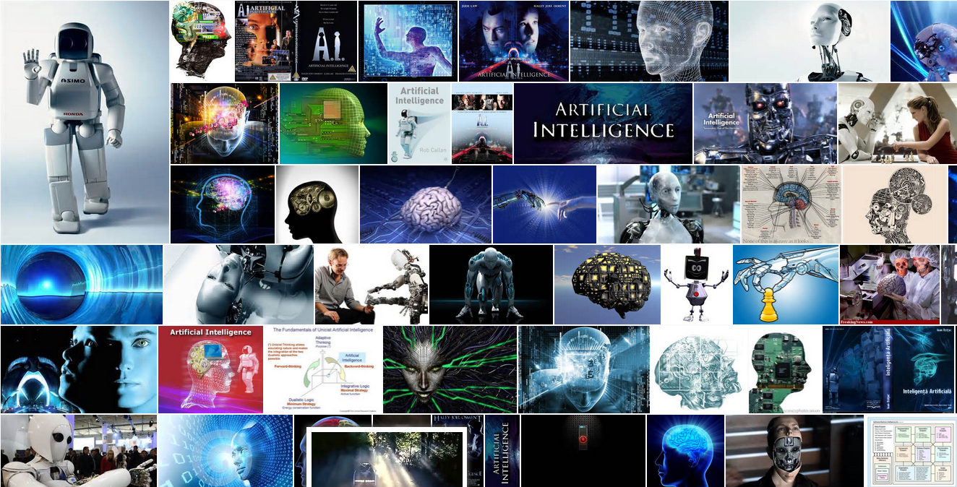
Dabarties kultūrinis kontekstas
https://images.search.yahoo.com/yhs/search;_ylt=A0LEVjJf5NFU.u8AbzInnIlQ?p=artificial+intelligence&fr=&fr2=piv-web&hspart=mozilla&hsimp=yhs-001
https://www.google.com/search?q=artificial+intelligence&lr=&source=lnms&tbm=isch&sa=X&ei=y-TRVPLGGIrzUr_egOAP&ved=0CAgQ_AUoAQ&biw=1600&bih=798
http://www.bing.com/images/search?q=artificial+intelligence&FORM=HDRSC2

Slide 3

History
Al-Jazari's programmable automata (1206 CE)

Slide 4
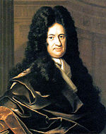
History
Gottfried Leibniz, who speculated that human reason could be reduced to mechanical calculation

Slide 5
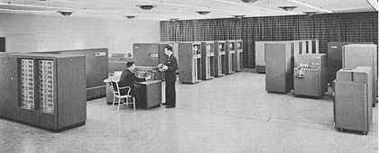
History
The IBM 702: a computer used by the first generation of AI researchers.

Slide 6
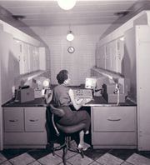

History
In 1951, using the Ferranti Mark 1 machine of the University of Manchester, Christopher Strachey wrote a checkers program and Dietrich Prinz wrote one for chess

Slide 7
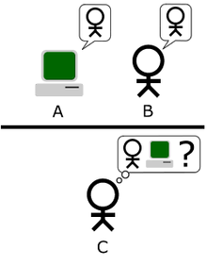
History
In 1950 Alan Turing published a landmark paper in which he speculated about the possibility of creating machines with true intelligence. He noted that "intelligence" is difficult to define and devised his famous Turing Test.

Slide 8
History
Strong AI
Searle identified a philosophical position he calls "strong AI":
The appropriately programmed computer with the right inputs and outputs would thereby have a mind in exactly the same sense human beings have minds.^{[g]}
The definition hinges on the distinction between simulating a mind and actually having a mind. Searle writes that "according to Strong AI, the correct simulation really is a mind. According to Weak AI, the correct simulation is a model of the mind."

Slide 9
History
Reasoning as search
Many early AI programs used the same basic algorithm. To achieve some goal (like winning a game or proving a theorem), they proceeded step by step towards it (by making a move or a deduction) as if searching through a maze, backtracking whenever they reached a dead end. This paradigm was called "reasoning as search".
The principal difficulty was that, for many problems, the number of possible paths through the "maze" was simply astronomical (a situation known as a "combinatorial explosion").

Slide 10
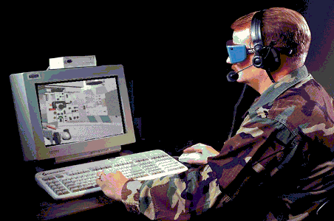
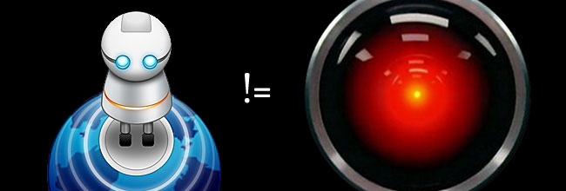
Natural language
(Natūralios kalbos sąsaja)
An important goal of AI research is to allow computers to communicate in natural languages like English.

Slide 11
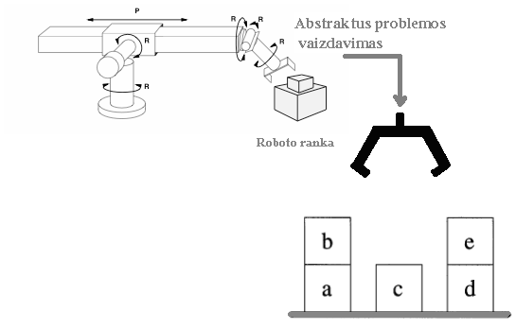

Micro-worlds
In the late 60s, Minsky proposed that AI research should focus on artificially simple situations known as micro-worlds.
He pointed out that in successful sciences like physics, basic principles were often best understood using simplified models like frictionless planes or perfectly rigid bodies.
Much of the research focused on a "blocks world," which consists of colored blocks of various shapes and sizes arrayed on a flat surface.

Slide 12
The first AI winter 1974–1980
Limited computer power: There was not enough memory or processing speed to accomplish anything truly useful. As of 2011, practical computer vision applications require 10,000 to 1,000,000 MIPS. By comparison, the fastest supercomputer in 1976, Cray-1 (retailing at $5 million to $8 million), was only capable of around 80 to 130 MIPS, and a typical desktop computer at the time achieved less than 1 MIPS.
Intractability and the combinatorial explosion. This almost certainly meant that many of the "toy" solutions used by AI would probably never scale up into useful systems.
Commonsense knowledge and reasoning. Many important artificial intelligence applications like vision or natural language require simply enormous amounts of information about the world: the program needs to have some idea of what it might be looking at or what it is talking about. This requires that the program know most of the same things about the world that a child does. Researchers soon discovered that this was a truly vast amount of information. No one in 1970 could build a database so large and no one knew how a program might learn so much information
Moravec's paradox: Proving theorems and solving geometry problems is comparatively easy for computers, but a supposedly simple task like recognizing a face or crossing a room without bumping into anything is extremely difficult. This helps explain why research into vision and robotics had made so little progress by the middle 1970s.
The frame and qualification problems. AI researchers who used logic discovered that they could not represent ordinary deductions that involved planning or default reasoning without making changes to the structure of logic itself. They developed new logics (like non-monotonic logics and modal logics) to try to solve the problems.

Slide 13
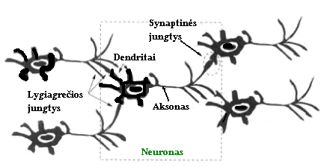
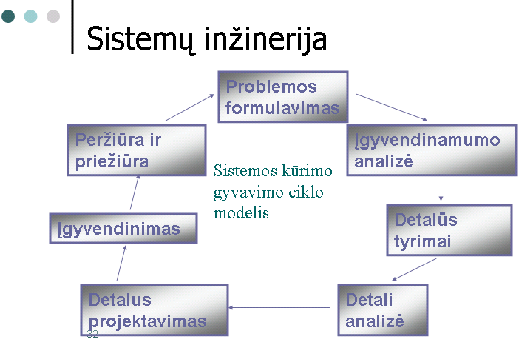
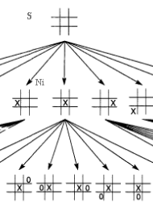
Dirbtinis intelektas ir informacinės sistemos

Slide 14

Pavyzdys : Finansų rinkos

Slide 15
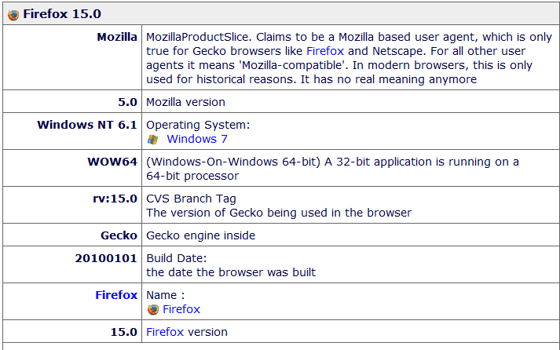
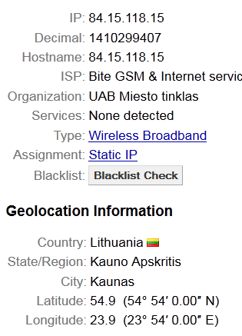
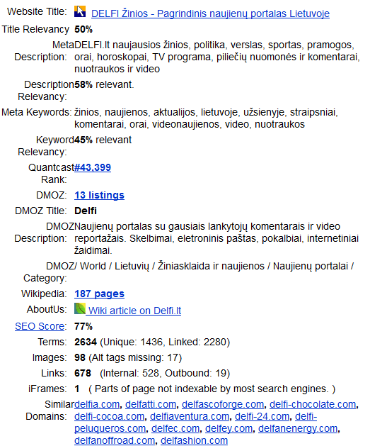
Pavyzdys : Interneto vartotojų sekimas

Slide 16
Įvadas

Slide 17

Įvadas

Slide 18

Įvadas

Slide 19

Įvadas

Slide 20


Įvadas

Slide 21
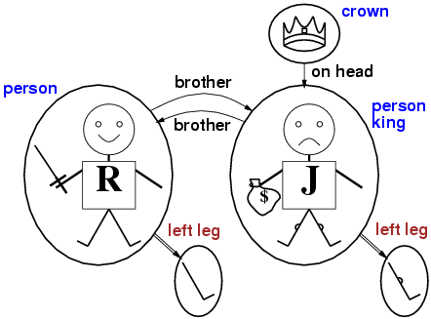
Įvadas

Slide 22
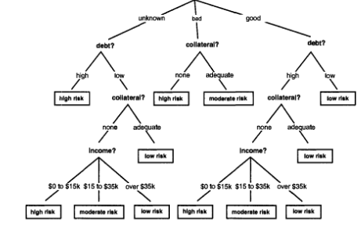
Įvadas

Slide 23
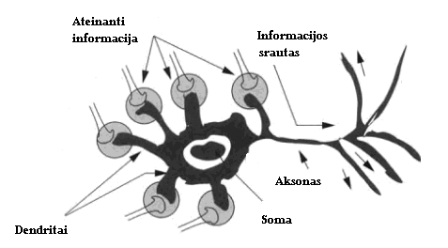
Įvadas

Slide 24
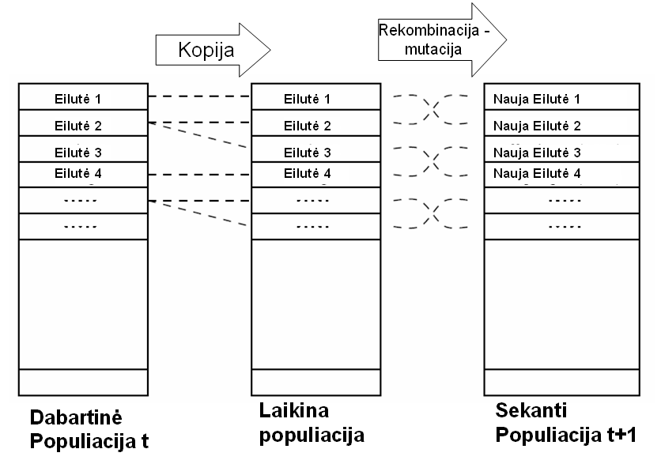
Įvadas
Evoliuciniai skaičiavimai Genetiniai algoritmai.

Slide 25
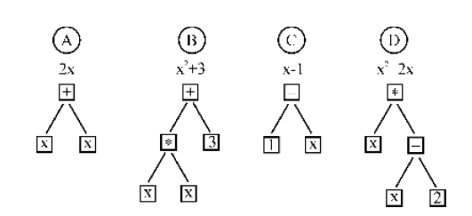
Įvadas
Keturi polinomai arba keturios programos sudarančios populiaciją GP algoritmo pradžioje.

Slide 26
Įvadas
JESS
WEKA

